Slide 1
Age of Empires II Battle Simulator
Mingyu Chen
School of Information Sciences
Dec 08, 2020

Slide 2
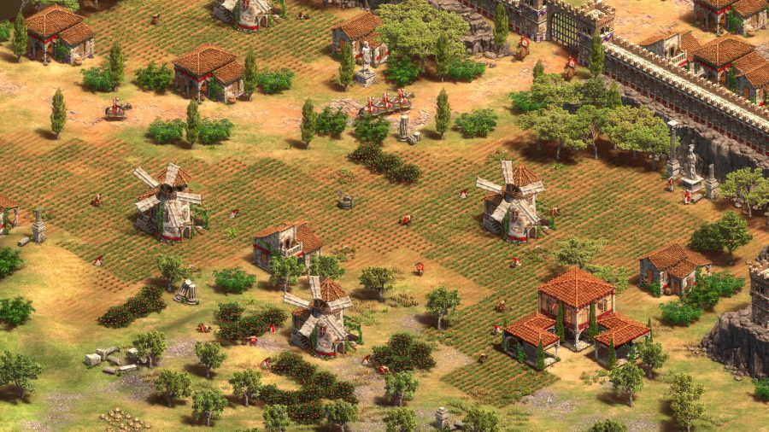
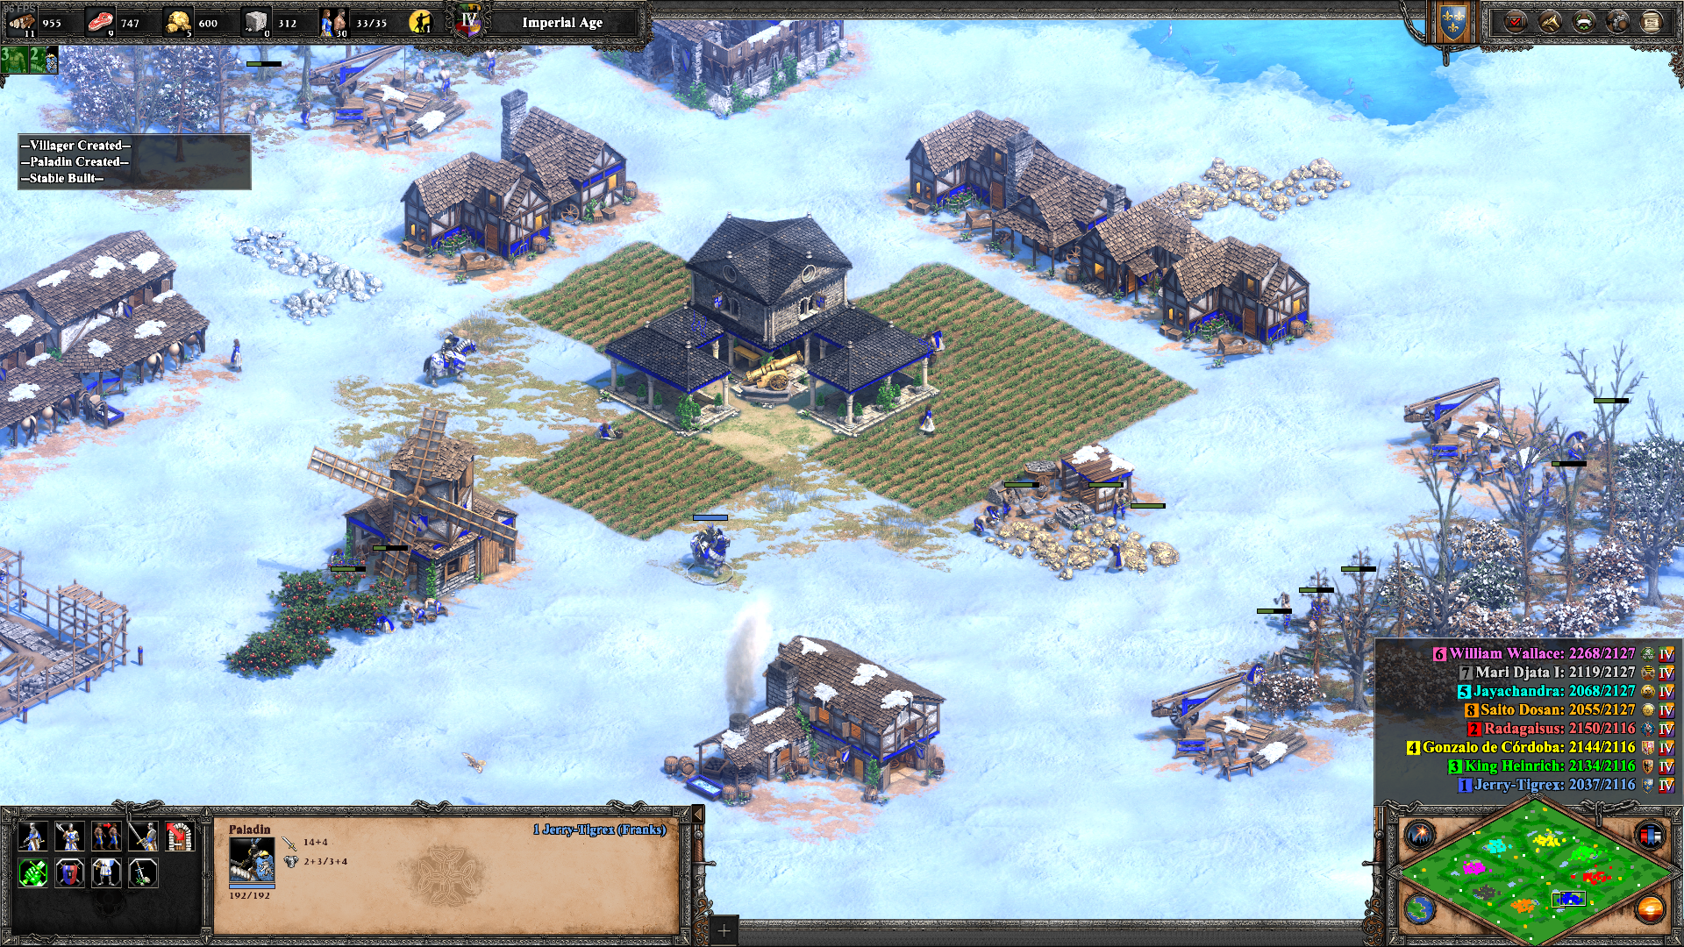
Background
Age of Empires II
Real-time strategy game first released in 1999.
Franks was famous for its cavalry and knights in history. Therefore, in the game, all cavalries from Franks will have 20% more health than other countries. That means, Franks’ paladins have 192 health, when other countries’ paladins have 160 (without Bloodlines) and 180 health (with Bloodlines)
Paladin is powerful cavalry with strong attack and armor (and looks gorgeous), but expensive to produce.
Questions:
How strong is Franks paladins against other units with additional health?

Slide 3
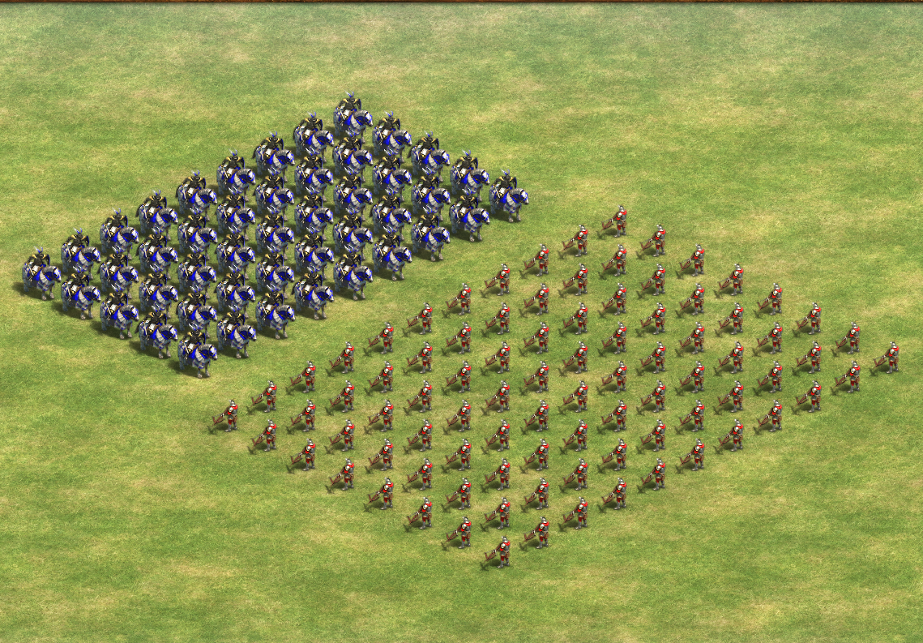
Scenario

Slide 4
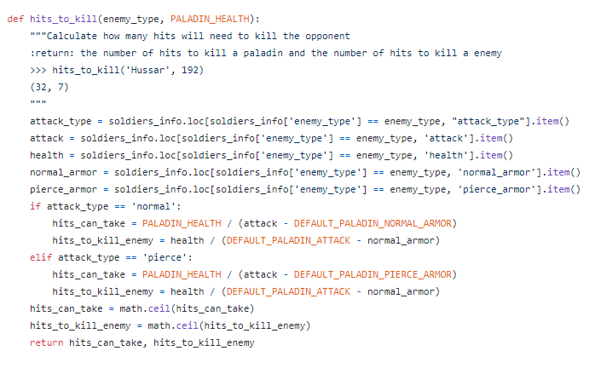
Structure
Hand-typed properties (attack, armor etc.) of different units, stored in a csv file.
After entering the enemy type you want to simulate, read information from the dataset and calculate the hits needed to kill the enemy (or be killed.)

Slide 5
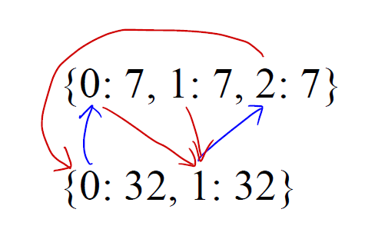
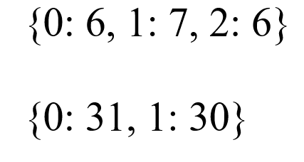
Core: simulating the battle
At the start of the battle

Slide 6
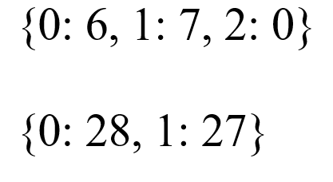
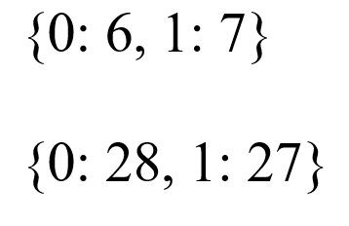
4. After each round
Check if anyone died. If a value reaches zero, we will remove the pair from the dictionary.

Slide 7
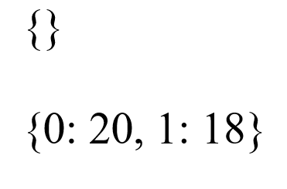
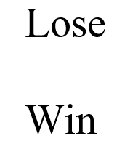
4.5. After each round
Check if any team got wiped out, after deleting the dead soldiers.
bool(dictionary)

Slide 8
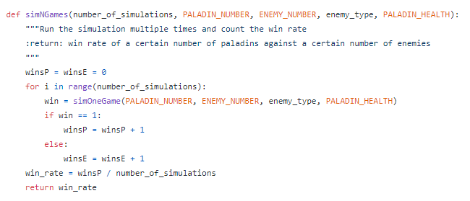
5. After each simulation
Count the number of wins for both teams, calculate the win rate for paladins.

Slide 9
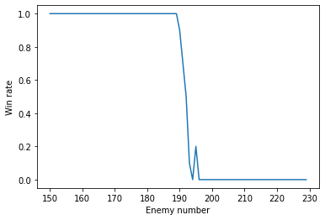

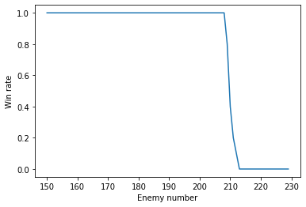

Simulation Results(against Arbalester)
Run the simulator 10 times
Run the simulator 500 times
160 health
192 health

Slide 10
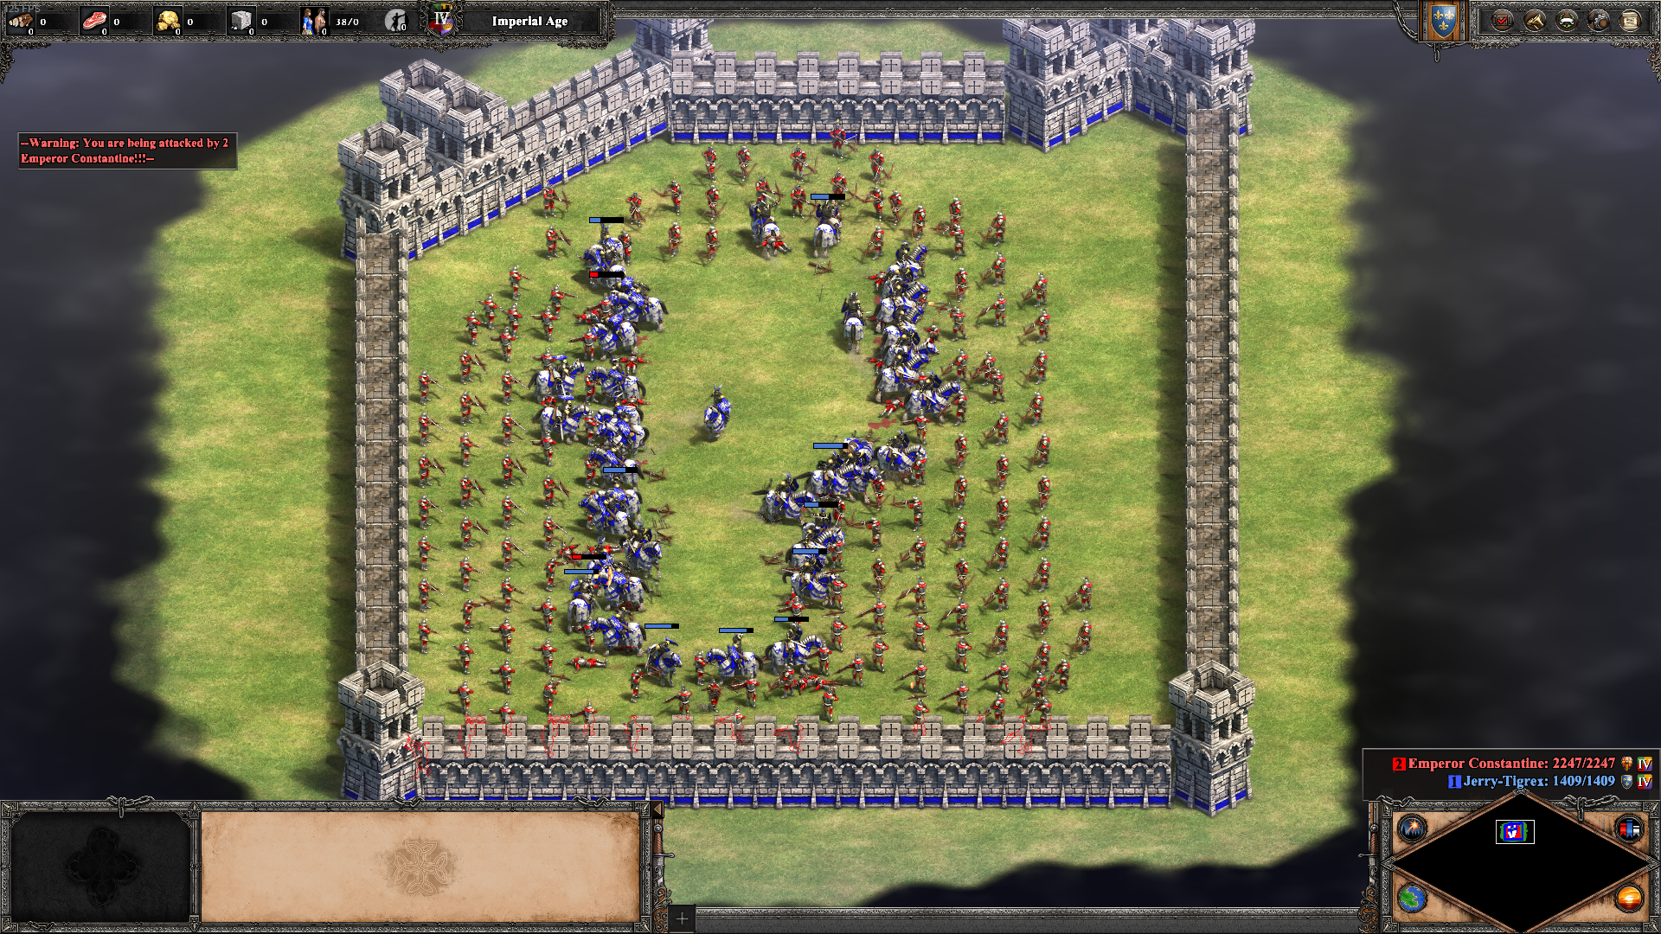

Slide 11
Possible Improvements
The range, speed, size, line of Sight of different units are not considered in this simulator.
Maybe I can add the coordinates of each soldier and let it attack the nearest enemy instead of randomly attacking and take the time to move into account. (However, in actual games, the AI is more sophisticated, and soldiers often attack at will.)
The simulator can be extended so user can select any type of soldiers for both sides. Maybe I can even add a GUI for this program.
The resources consumed to produce the soldiers are not considered in the battle.

Slide 12
Thank you for listening!
Thank you Mr. Weible!

